Slide 1
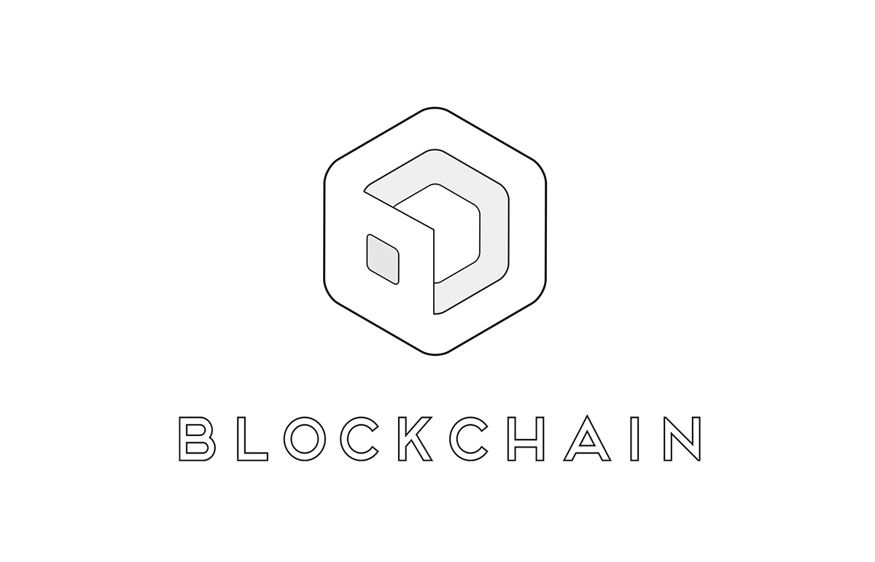

Slide 2
Content
An introduction of blockchain
Applications of blockchain
Future of blockchain

Slide 3

a trusted third party
use the currency issued by the state to buy goods
are willing to store the money in the bank

Slide 4

Satoshi Nakamoto
2008 financial crisis

Slide 5

a peer-to- peer electronic cash system
does not need a third party
uses digital signatures to solve payment problems
use blockchain to solve the double spending problem

Slide 6

Each node has a separate data and the data is same with the other nodes
The data is stored in the local hard disk and memory
The consensus of blockchain is that every nodes try to extend the main chain.

Slide 7


→
validate
→
add it to their chain
blockchain
recognizes the chain that most people agree

Slide 8
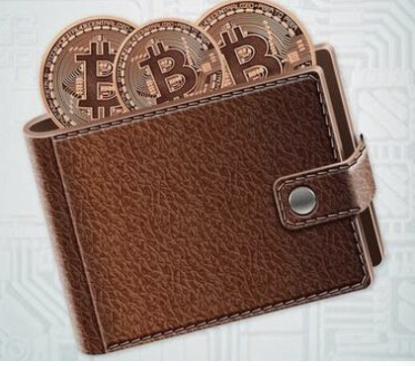
anonymity
→
address
does not record our balance directly, but records all our transactions
If you want to know the balance, you can calculate it through all the transactions

Slide 9

the private key corresponds to the public key through the elliptical equation
the public key gets the public key hash through the two hash functions of SHA256 and RIPEMD160
public key hash can transform to the wallet address through Base 58 code
identity authentication

Slide 10


Bitcoin will not be issued infinitely
Everyone keep accounts at the same time
The first people who finish keeping accounts will receive a certain amount of bitcoin as an award

Slide 11

→
compete
solving mathematical puzzles

Slide 12
After every blocks completed, the difficulty of calculation changes . To control the number of issues, only transactions can be recorded second, generating block every minutes. At first, a block was packaged to reward bitcoins, and after each of the blocks, the reward will halve.
2016
once
7
per
1
10
50
210,000

Slide 14
WHAT IS

Slide 15
PoW

Slide 16
PoS
PoW

Slide 17






PoW
PoS
consensus mechanisms
generating
maintaining

Slide 18
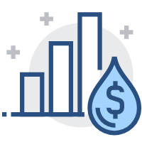

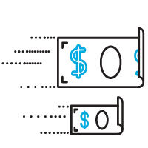

PoW
More work you did
More chance you got

Slide 19
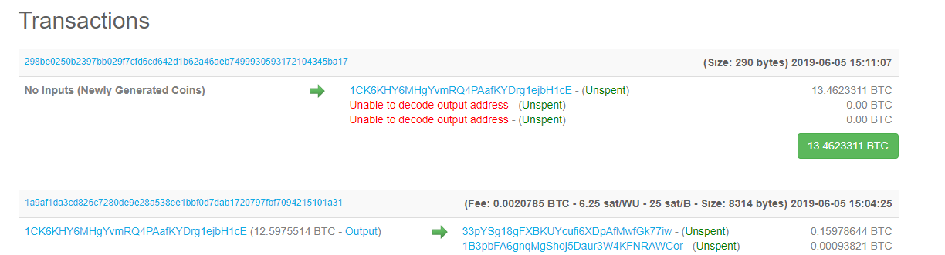

Coinbase transaction
miner's account

Slide 20





Block header
Block body

Slide 21
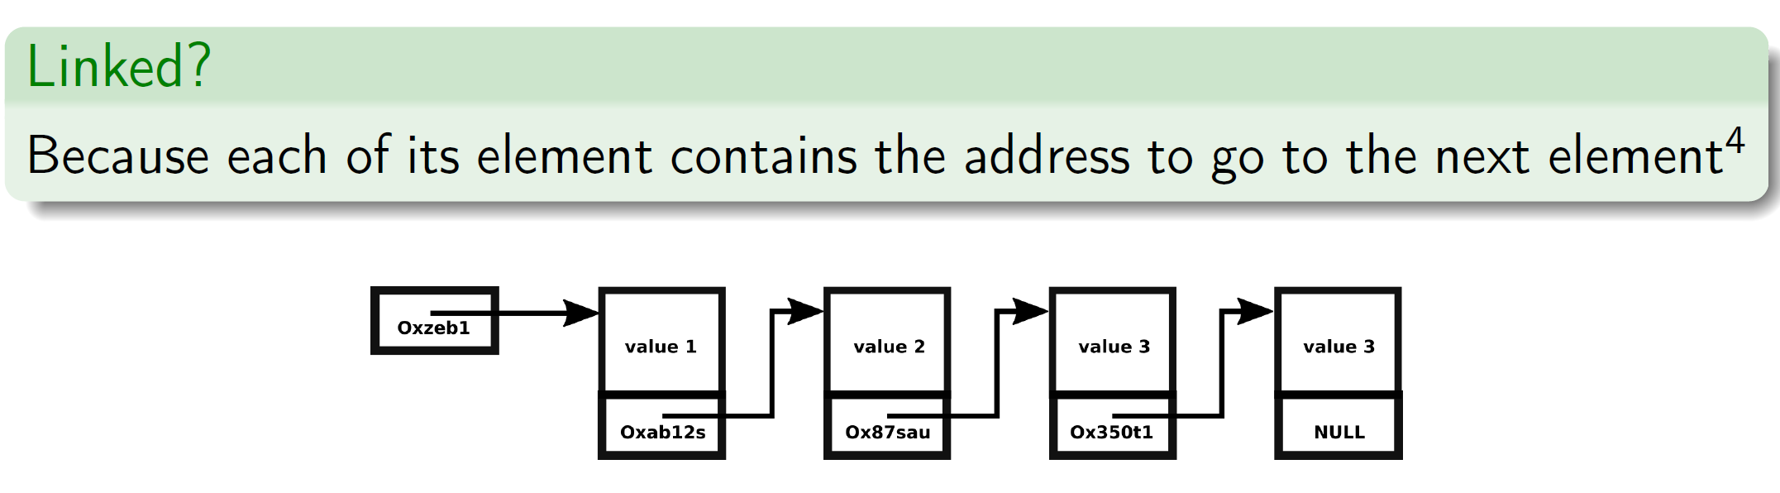

Slide 22

Block header
Hash pointer
Previous block
(key,value)
Block body

Slide 23




H(Block header) ≤ target
Broadcasting
Verification

Slide 24
PoW
Simple algorithm
Using acceptable mathematical logic
Safe
Wasting too much power
Concentration of calculation force
Hidden danger of 51% attack

Slide 25

PoS
More
Number of coins and
Age of coins you had
More chance you got
√ → 0↓

Slide 26
No need to mine
Do not waste electricity
Shorten the time of consensus reached
Decline the amount of currency in circulation
Other attacks
Forking

Slide 27
All consensus mechanisms are designed to solve specific problems, none of which is flawless. All of them has its own pros and cons, takes what.

Slide 28
Applications of blockchain

Slide 29
Shortcuts of traditional medical data system
information islands
tampering distortion
record omission
disclosure of individual privacy

Slide 30


Companies using blockchain in medical area
IBM Watson and FDA
Google’s DeepMind

Slide 31
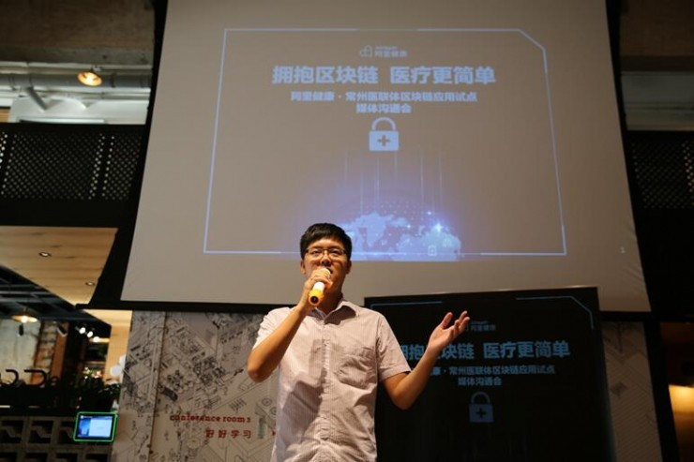
Changzhou Medical Union Blockchain Pilot with Ali Health
Changzhou medical reform
Solve the isolated islands
Protect privacy

Slide 32
Solve the isolated islands
Protect privacy
Patient’s data are privacy.
The patient's visit information will be transmitted on the blockchain and encrypted.
The data is stored in the distributed ledger, which cannot be changed.
Query historical medical data
Connection of old IT devices and system information

Slide 33
Future of blockchain

Slide 34
Development Stage
The Embroyo Stage
Cryptocurrency-Bitcoin
Smart Contract Blockchain
Programmable Finance
Programmable Trust
Next Generation of Blockchain
Programmable Society-culture, art, economics, science, medical,etc
2008
2013
......

Slide 35


Basic information
Medical history
Test results
Drug description
Diagnostic
............
Basic information
File management
Grade
Educational Background
.............

Slide 36
Conclusion

Slide 37


